Slide 1


SIR CRR COLLEGE OF ENGINEERING
UNDER THE GUIDANCE OF

Slide 2
CONTRIBUTERS :
K. JAYADITYA
K.GOUTHAM
K.CHAITANYA
K.KRISHNA RAO
M.VAMSI KRISHNA

Slide 3
AIM : BILL SPLITTER
TOOLS USED :
BUTTONS
LABELS
TEXT BOX
ACCELEROMETER SENSOR
NOTIFIER

Slide 4
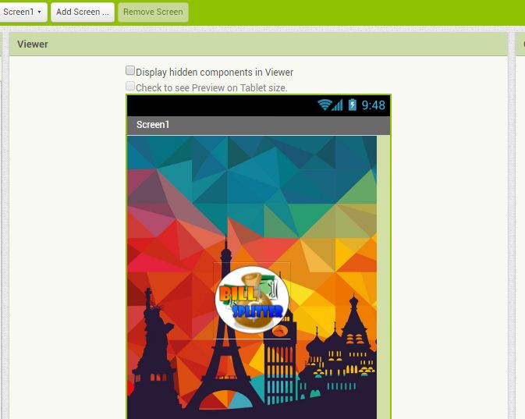
SCREEN ONE OF BILL SPLITTER :

Slide 5
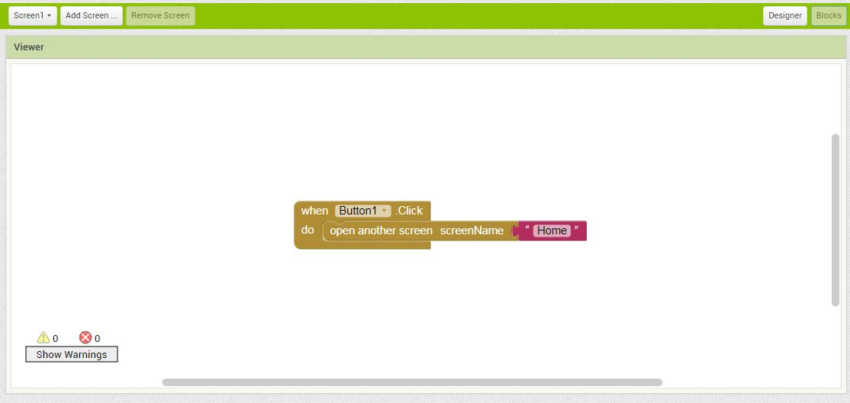
BLOCK OF SCREEN ONE :

Slide 6
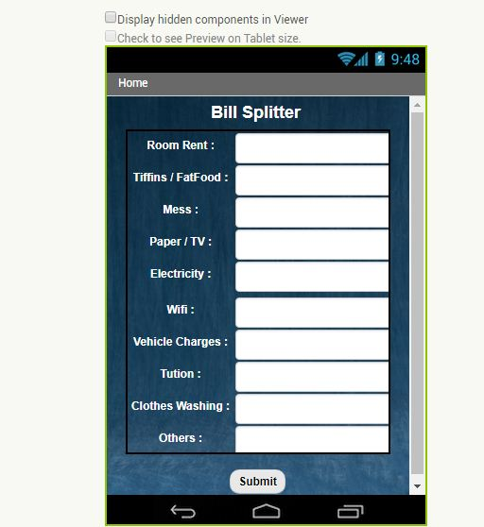
HOME PAGE OF BILL SPLITTER :

Slide 7
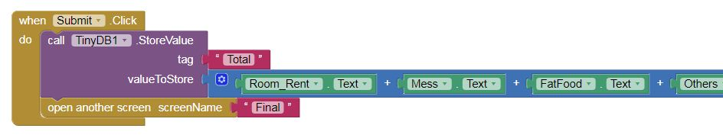
BLOCK OF HOME PAGE :

Slide 8
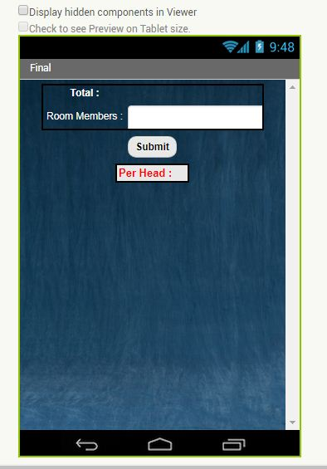
FINAL SCREEN OF BILL SPLITTER :

Slide 9
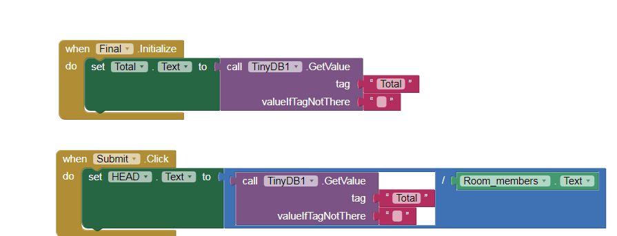
BLOCK :

Slide 10
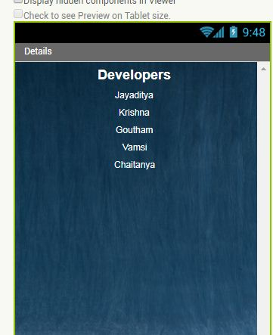
DETAILS PAGE OF BILL SPLITTER :

Slide 11
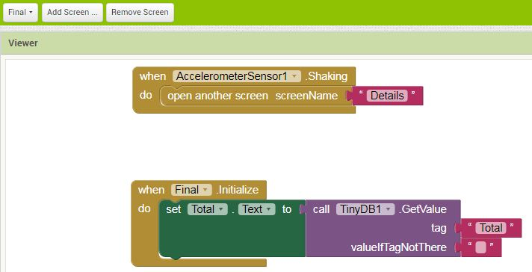
BLOCK :

